Slide 1


Chapter 7
E-Procurement

Slide 2
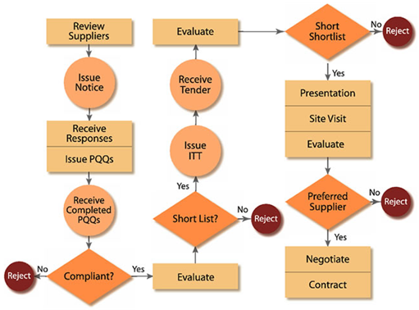
A Scenario..
Example of procurement process
PQQ-Pre Qualification Questionnaire, ITT- Invitation To Tender

Slide 3
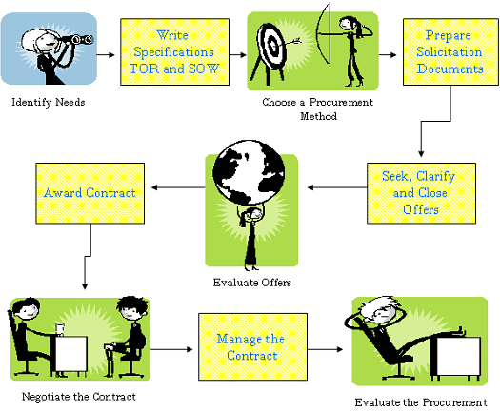
Another Scenario..
Example of procurement process
SOW- Scope of work , TOR - Tactical Operational Requirement

Slide 4
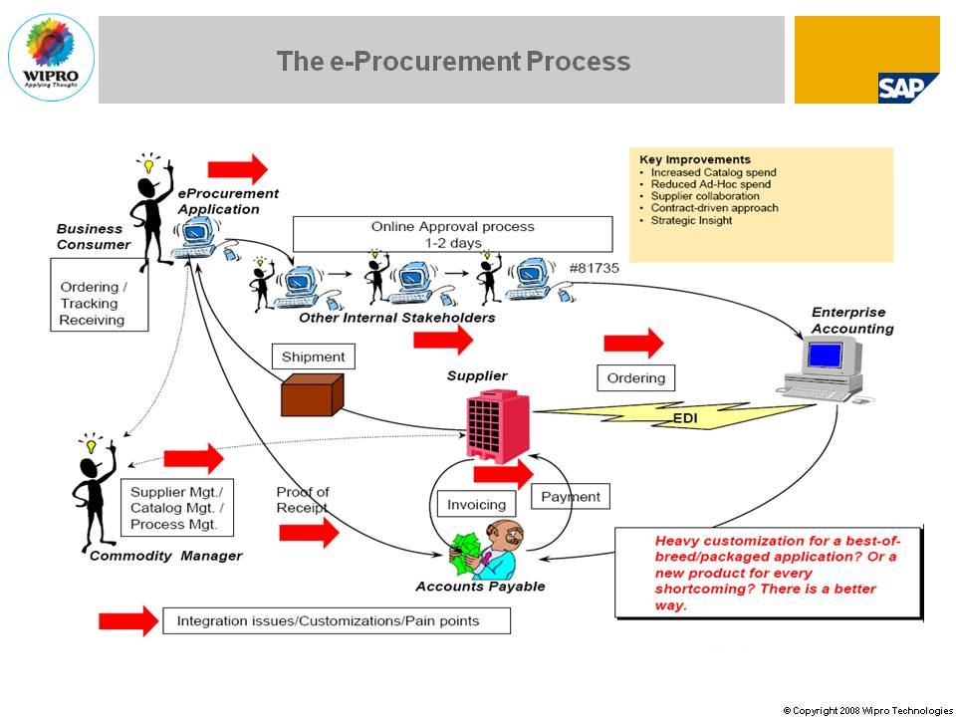
Another scenario… e-procurement
Example of e-procurement process

Slide 5
What is e-procurement?
The electronic integration and management of all procurement activities including purchase request, authorization, ordering, delivery and payment between a purchaser and a supplier

Slide 6
What is e-procurement?
The 5 rights of e-procurement
at the right price
delivered at the right time
are of the right quality
of the right quantity
from the right source.

Slide 7
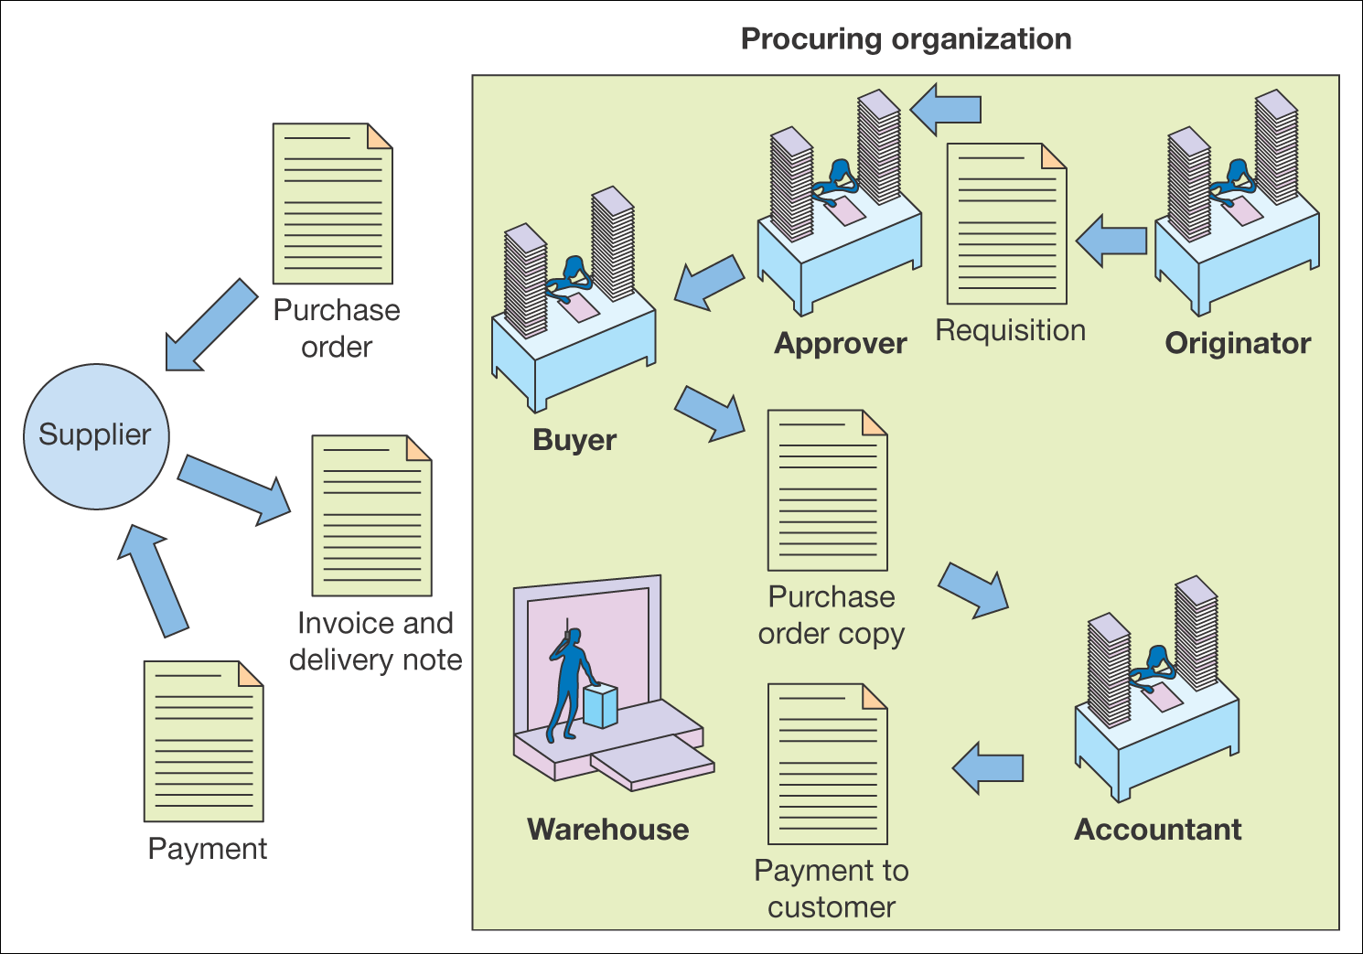
What is e-procurement?
Figure 7.1 Key procurement activities within an organization

Slide 8
Types of procurement
Production-related procurement
Non-production related procurement
How items are bought:
Systematic sourcing
Spot sourcing

Slide 9
Drives of e-procurement
Cost reduction
Enhanced budgetary control
Elimination of administrative errors
Increasing buyer’s productivity
Improving information management
Improving the payment process

Slide 10
Risks and impact of e-procurement
Organizational risks
Need to redeploy staff
Technology risks
Integration with existing financial systems

Slide 11
Implementing e-procurement
Stock control system
CD/web-based catalogue
E-mail/workflow system
Order-entry on web site
Accounting systems
ERP systems

Slide 12
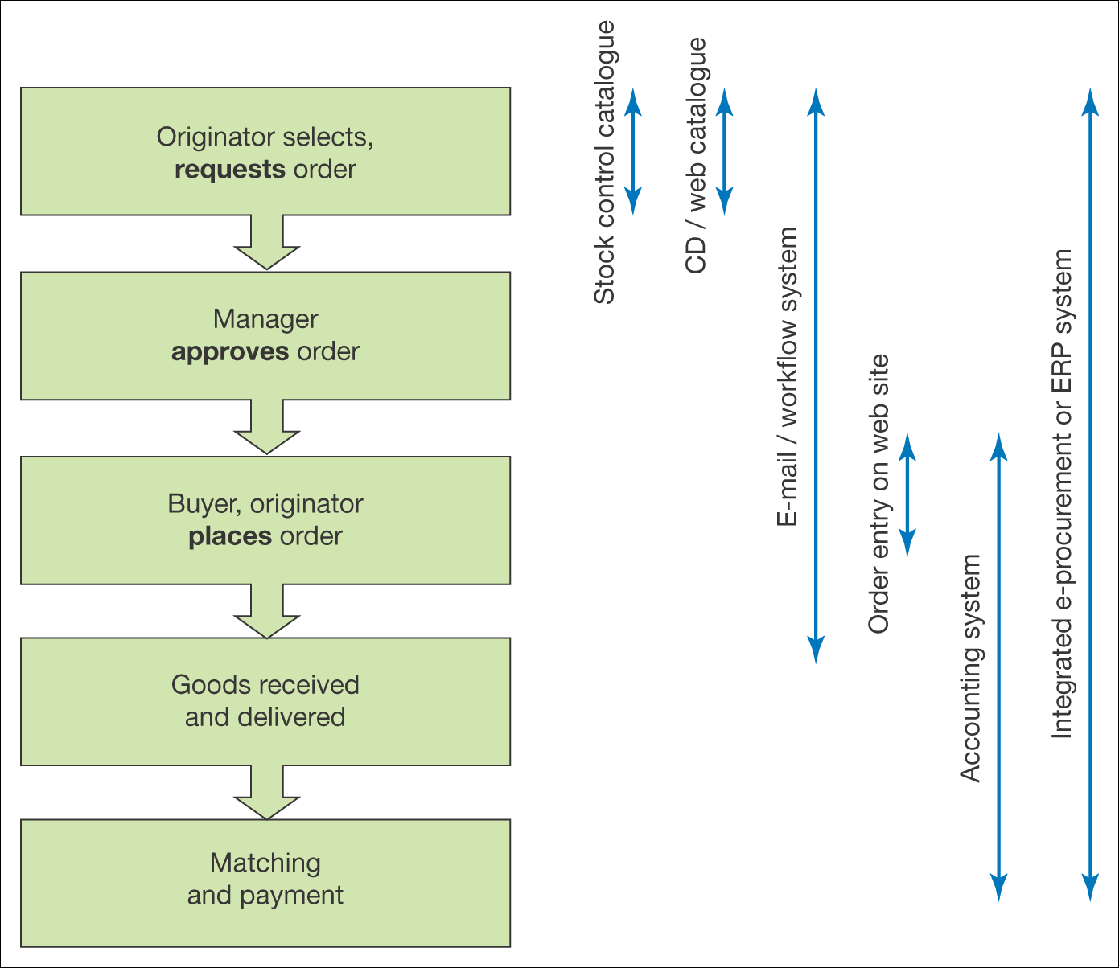
Implementing e-procurement
Figure 7.3 Use of different information systems for different aspects of the fulfilment cycle

Slide 13
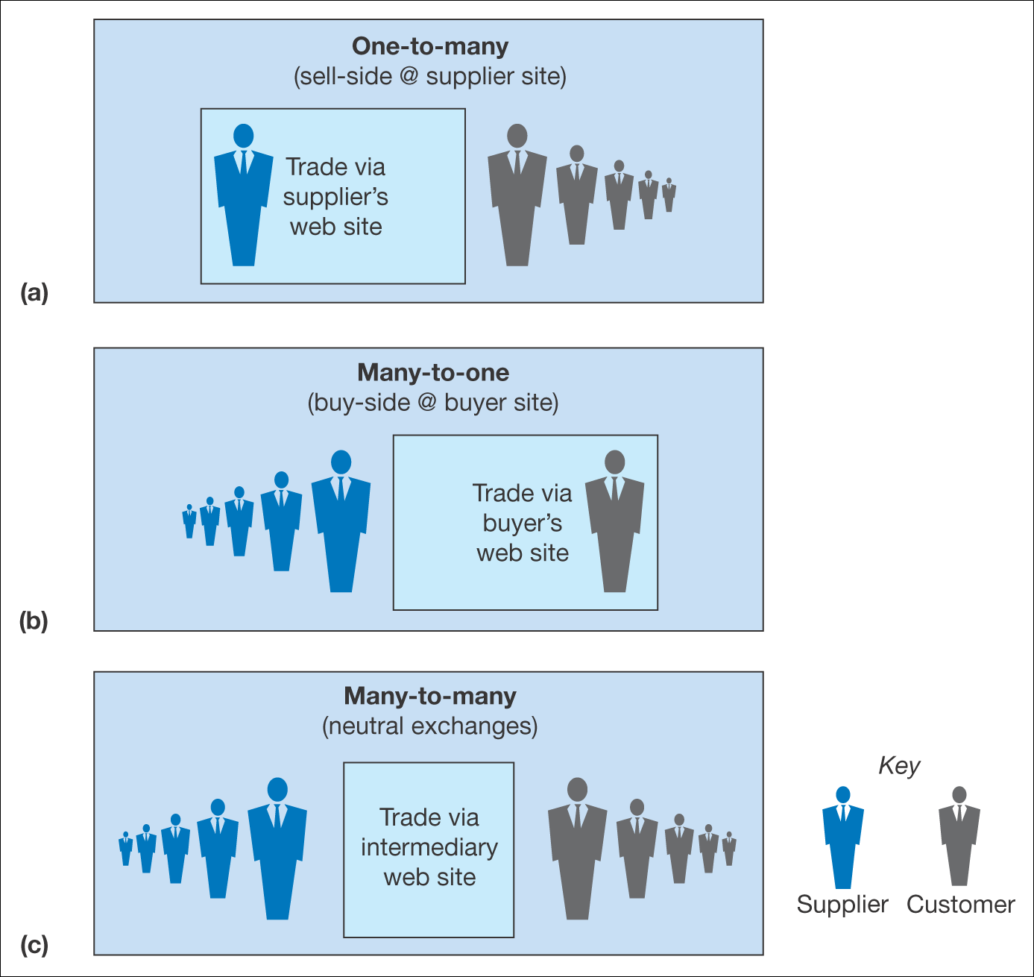
Integrating company systems with suppliers systems
Figure 7.6 The three main e-procurement model alternatives for buyers

Slide 14
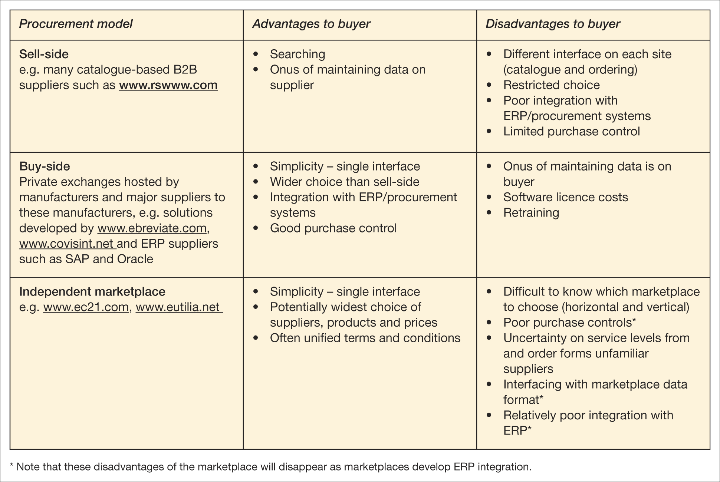
Integrating company systems with suppliers systems
Table 7.6 Assessment of the procurement model alternatives for buyers

Slide 15
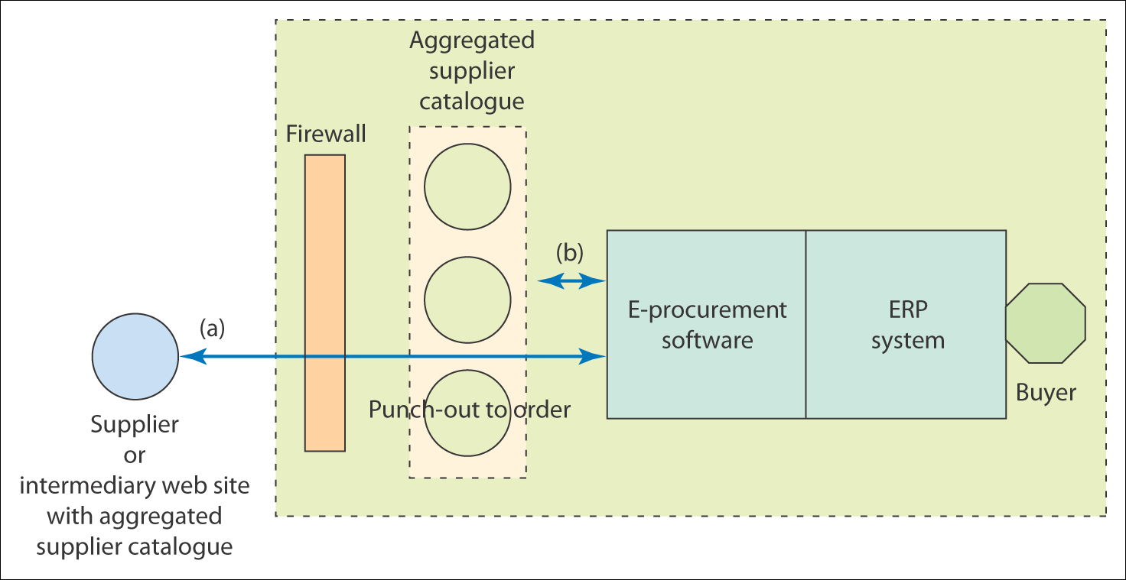
Integrating company systems with suppliers systems
Figure 7.7 Integration between e-procurement systems and catalogue data

Slide 16
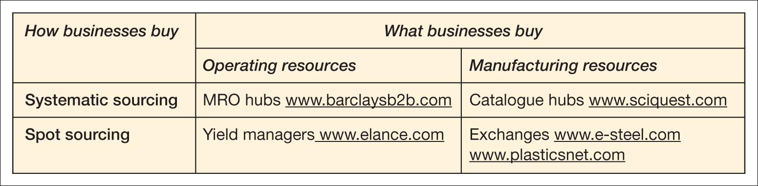
Types of marketplace
Table 7.7 Types of B2B marketplaces identified by Kaplan and Sawhney (2000) with examples
Source: Adapted and reprinted by permission of Harvard Business Review from table on p. 99 from ‘E-hubs: the new B2B marketplaces,’ by Kaplan, S. and Sawhney, M., in Harvard Business Review, May–June 2000. Copyright © 2000 by the Harvard Business School Publishing Corporation, all rights reserved

Slide 17
Summary
E-procurement – the electronic integration of all procurement activities
To reduce purchasing cycle time and cost savings- time spent in procurement and lower inventory

